Slide 1
Fundamentals of CRE
Chemical Reaction Engineering
By
Dr Salah N. Farhan
Senior lecturer. Chem. Eng. Dept.
College of Engineering
University of Diyala
Salah N. Farhan College of Engineering Diyala University

Slide 2
Fundamentals of CRE
Chapter 11: Pressure Drop
Salah N. Farhan College of Engineering Diyala University

Slide 3
Block 1: Mole Balances
Block 2: Rate Laws
Block 3: Stoichiometry
Block 4: Combine
Pressure Drop
  Liquid Phase Reactions
  Gas Phase Reactions
  Engineering Analysis of Pressure Drop

Slide 4
Pressure Drop in PBRs
Concentration Flow System:
Gas Phase Flow System:

Slide 5
Pressure Drop in PBRs
Note: Pressure Drop does NOT affect liquid phase reactions
Sample Question:
Analyze the following second order gas phase reaction that occurs isothermally in a PBR:
A→B
Mole Balances
Must use the differential form of the mole balance to separate variables:
Rate Laws
Second order in A and irreversible:

Slide 6
Pressure Drop in PBRs
Stoichiometry
Isothermal, T=T₀
Combine:
Need to find (P/P₀) as a function of W (or V if you have a PFR)

Slide 7
Pressure Drop in PBRs
Ergun Equation:
Constant mass flow:

Slide 8
Pressure Drop in PBRs
Variable Density
Let

Slide 9
Pressure Drop in PBRs
Catalyst Weight
Where
Let

Slide 10
Pressure Drop in PBRs
We will use this form for single reactions:
Isothermal case

Slide 11
Pressure Drop in PBRs
and
or
The two expressions are coupled ordinary differential equations. We can only solve them simultaneously using an ODE solver such as Polymath. For the special case of isothermal operation and epsilon = 0, we can obtain an analytical solution.
Polymath will combine the Mole Balances, Rate Laws and Stoichiometry.

Slide 12
Packed Bed Reactors

Slide 13
1
Pressure Drop in a PBR
P
W

Slide 14
2
Concentration Profile in a PBR
C_{A}
W

Slide 15
3
Reaction Rate in a PBR
-r_{A}
W

Slide 16
4
Conversion in a PBR
X
W

Slide 17
5
Flow Rate in a PBR
1
W

Slide 19
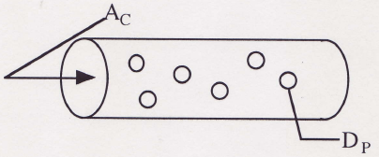
Example 1:
Gas Phase Reaction in PBR for δ=0
Gas Phase reaction in PBR with δ = 0 (Analytical Solution)
A + B → 2C
Repeat the previous one with equimolar feed of A and B and:
k_{A} = 1.5dm⁶/mol/kg/min
α = 0.0099 kg⁻¹
Find X at 100 kg

Slide 20
Example 1:
Gas Phase Reaction in PBR for δ=0
1) Mole Balance
2) Rate Law
3) Stoichiometry

Slide 21
Example 1:
Gas Phase Reaction in PBR for δ=0
,
,
4) Combine

Slide 22
Example 1:
Gas Phase Reaction in PBR for δ=0

Slide 23
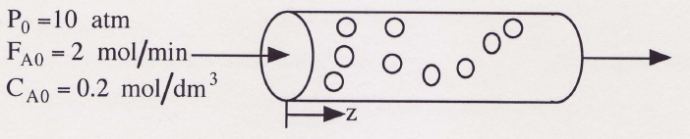
Example 2:
Gas Phase Reaction in PBR for δ≠0
The reaction
A + 2B → C
is carried out in a packed bed reactor in which there is pressure drop. The feed is stoichiometric in A and B.
Plot the conversion and pressure ratio y = P/P₀ as a function of catalyst weight up to 100 kg.
Additional Information
k_{A} = 6 dm⁹/mol²/kg/min
α = 0.02 kg⁻¹

Slide 24
Example 2:
Gas Phase Reaction in PBR for δ≠0
A + 2B → C
1) Mole Balance
2) Rate Law
3) Stoichiometry: Gas, Isothermal

Slide 25
Example 2:
Gas Phase Reaction in PBR for δ≠0
4)
5)
6)
7)
Initial values: W=0, X=0, y=1
Final values: W=100
Combine with Polymath.
If δ≠0, polymath must be used to solve.

Slide 26
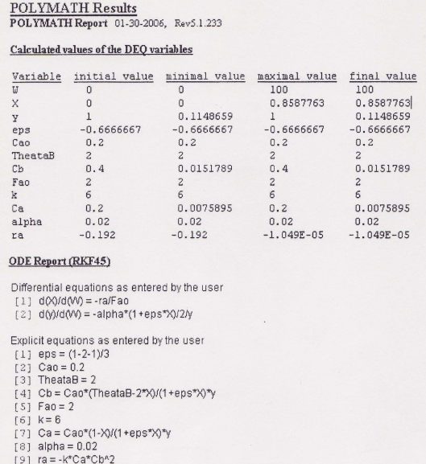
Example 2:
Gas Phase Reaction in PBR for δ≠0

Slide 27
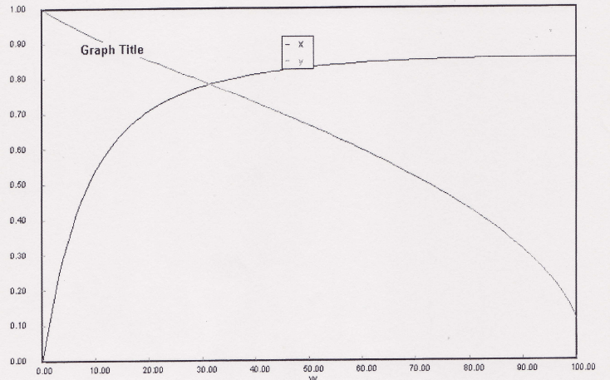
Example 2:
Gas Phase Reaction in PBR for δ≠0

Slide 28
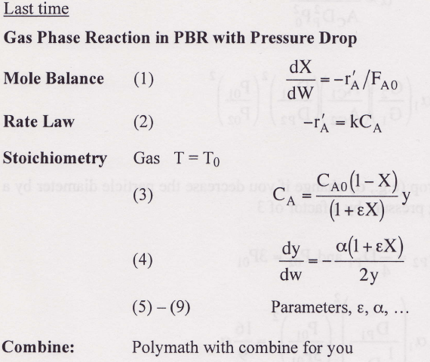
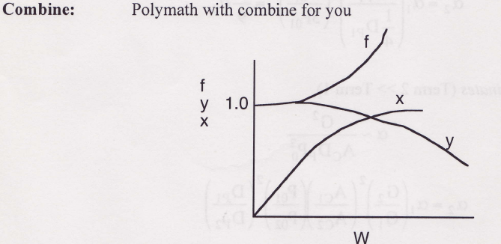
T = T₀

Slide 29

Robert the Worrier wonders: What if we increase the catalyst size by a factor of 2?

Slide 30
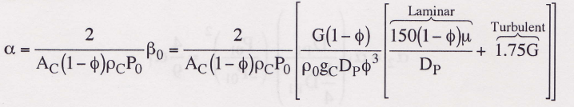
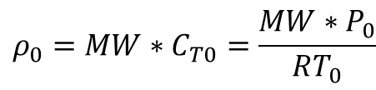
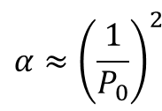
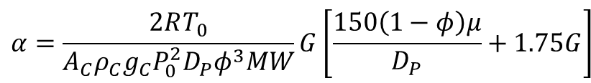
Pressure Drop
Engineering Analysis
$$ρ_{0}=MW∗C_{T0}=\frac{MW∗{ P}_{0}}{RT_{0}}$$
$$α=\frac{2RT_{0}}{A_{C}ρ_{C}g_{C}P_{0}^{2}D_{P}φ^{3}MW}G\left[\frac{150\left(1−φ\right)μ}{D_{P}}+1.75G\right]$$
$$α≈{\left(\frac{1}{P_{0}}\right)}^{2}$$

Slide 31
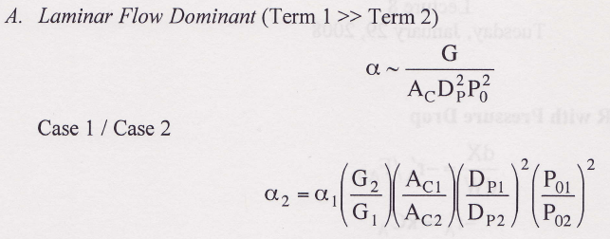
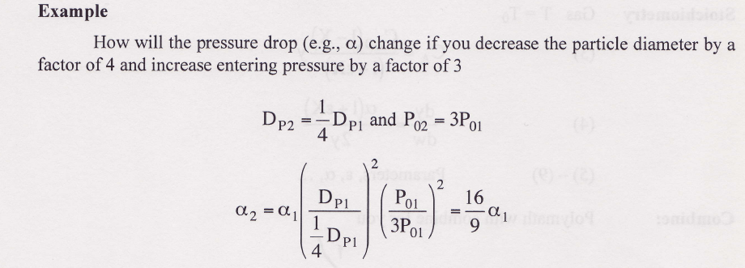
Pressure Drop
Engineering Analysis

Slide 32
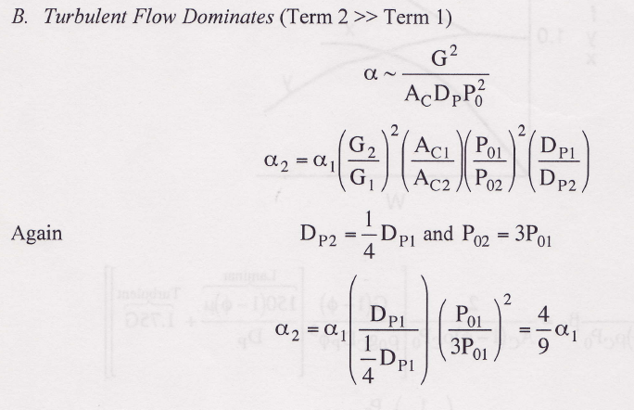
Pressure Drop
Engineering Analysis

Slide 33
Heat Effects
Isothermal Design
Stoichiometry
Rate Laws
Mole Balance

Slide 34
End of Lecture 8

Slide 35
Fundamentals of CRE
Salah N. Farhan College of Engineering Diyala University

Slide 36
Fundamentals of CRE
Salah N. Farhan College of Engineering Diyala University

Slide 37
Fundamentals of CRE
Salah N. Farhan College of Engineering Diyala University

Slide 38
Fundamentals of CRE
Salah N. Farhan College of Engineering Diyala University

Slide 39
Fundamentals of CRE
Salah N. Farhan College of Engineering Diyala University

Slide 40
Fundamentals of CRE
Salah N. Farhan College of Engineering Diyala University

Slide 41
Fundamentals of CRE
Salah N. Farhan College of Engineering Diyala University

Slide 42
Fundamentals of CRE
Salah N. Farhan College of Engineering Diyala University

Slide 43
Fundamentals of CRE
Salah N. Farhan College of Engineering Diyala University

Slide 44
Fundamentals of CRE
Salah N. Farhan College of Engineering Diyala University

